Slide 1



Responsible quantification
Andrea Saltelli
Open Evidence Research, Open University of Catalonia
Centro per l’Eccellenza e gli Studi Transdisciplinari (CEST), Young Scholar Initiative of the Institute for New Economic thinking (INET) and OECD
Forecasting the future for sustainable development
Approaches to Modelling and the Science of Prediction
June 16, 2021

Slide 2
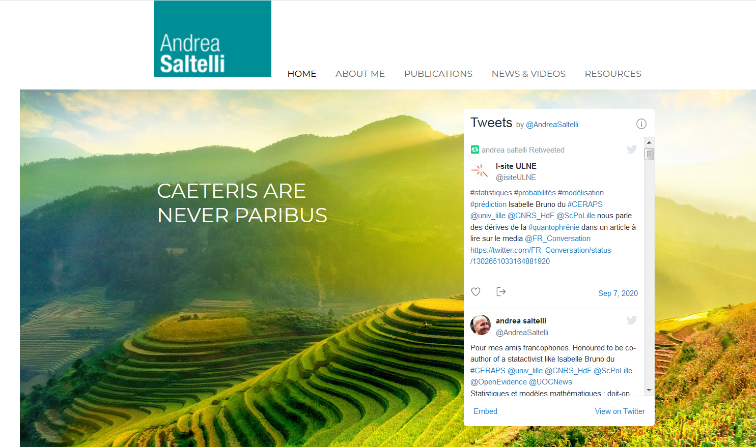
Where to find this talk: www.andreasaltelli.eu

Slide 3
Sociology and ethics of quantification
Espeland, W.N., Stevens, M.L., 2008. A sociology of quantification. Eur. J. Sociol. 49, 401–436. https://doi.org/10.1017/S0003975609000150

Slide 4

“what qualities are specific to rankings, or indicators, or models, or algorithms?”
Elizabeth
Popp Berman
E. Popp Berman and D. Hirschman, The Sociology of Quantification: Where Are We Now?, Contemp. Sociol., vol. in press, 2017.
Mennicken, A., Espeland, W.N., 2019. What’s New with Numbers? Sociological Approaches to the Study of Quantification. Annu. Rev. Sociol. 45, 223–245. https://doi.org/10.1146/annurev-soc-073117-041343

Slide 5
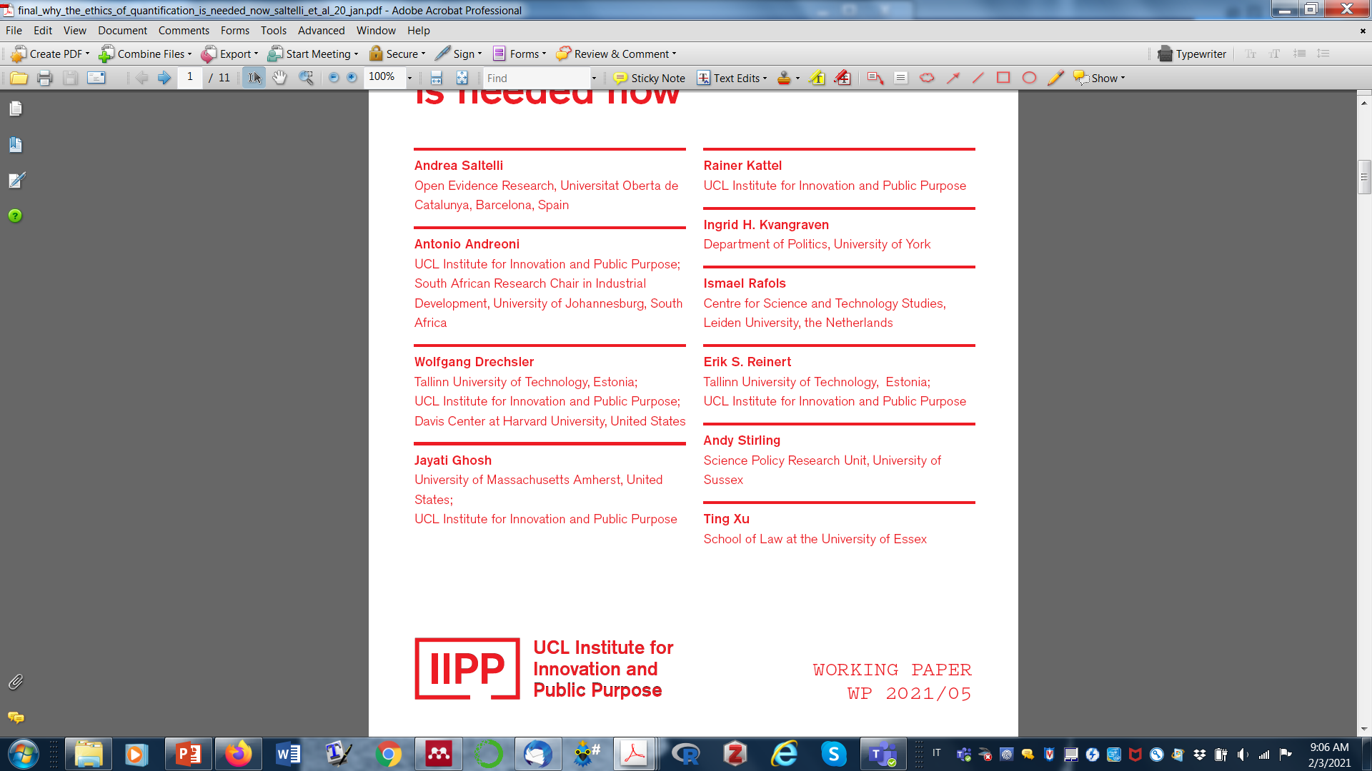
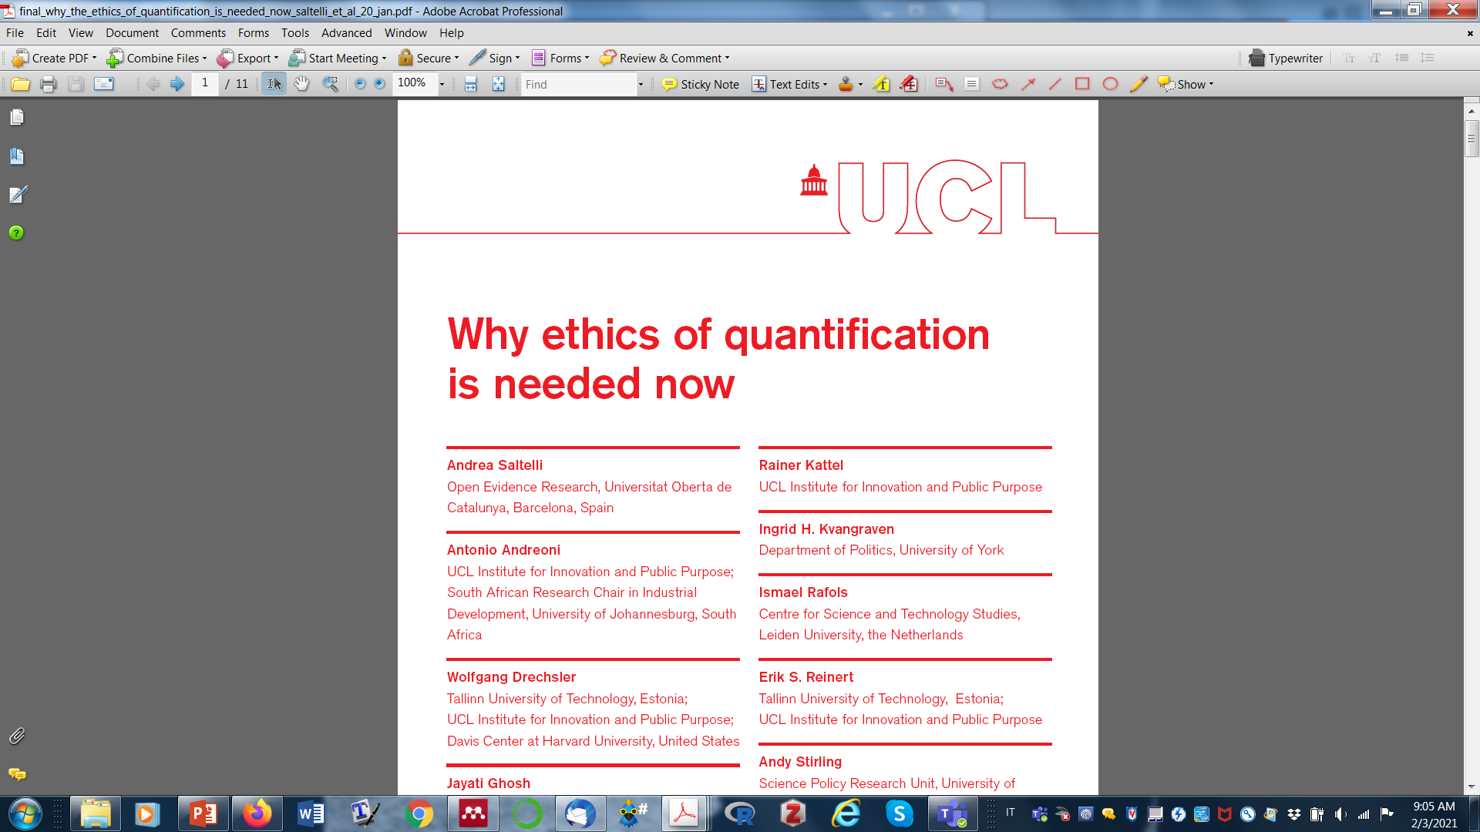

Slide 6
… our world is structured by numbers, visible and invisible, where truth is conveyed and reality constructed
Numbers are seductive, performative, confer to their masters' epistemic power and legitimacy
Governing the modern state, or even contesting it, without numbers is impossible
Numbers are the prevalent means to express value in our societies … Access & production of numbers reflect and reinforce power imbalances

Slide 7



Slide 8

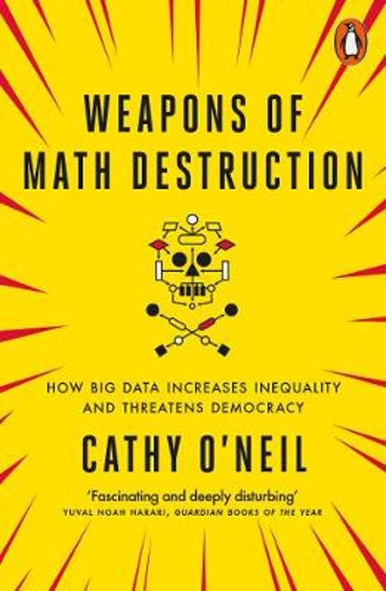


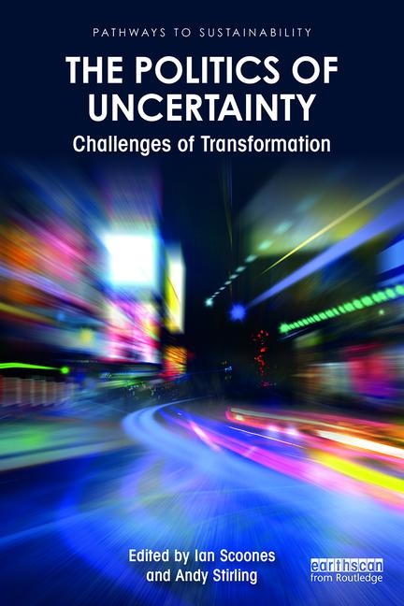



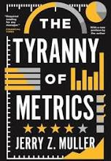
An explosion of works, from within and without, from many disciplines

Slide 9
Numbers and their ‘reactivity’
(Espeland and Sauder, 2016)
Incumbent numbers affect what society will measure in the future (Merry 2016)
Numbers “create the environment that justifies their assumptions” (O’Neil, 2016)

Slide 10
Statistical and mathematical modelling

Slide 11
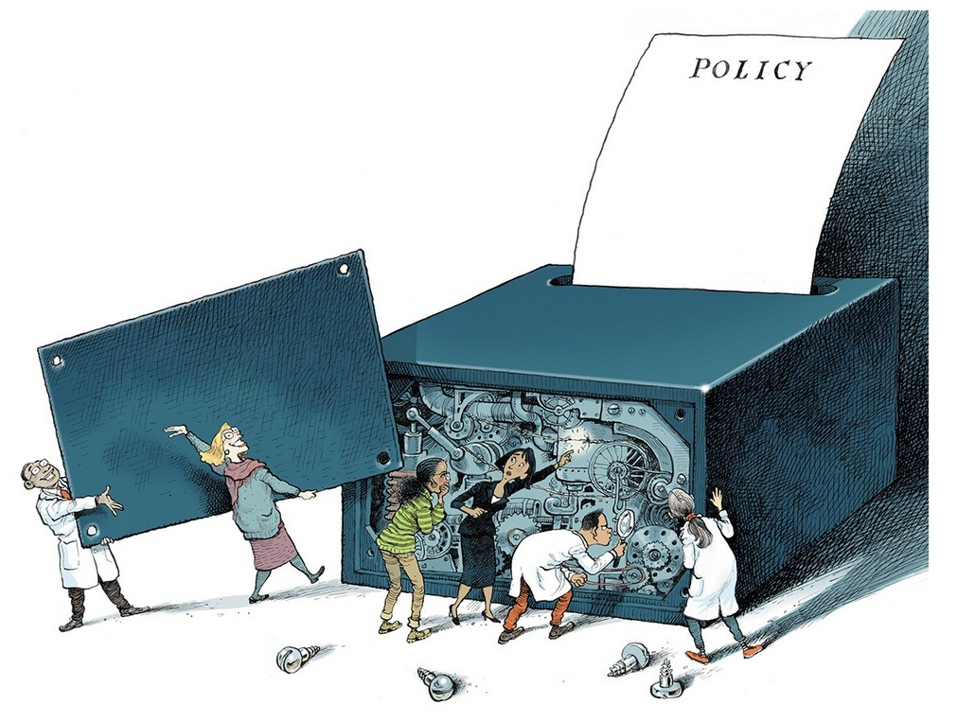
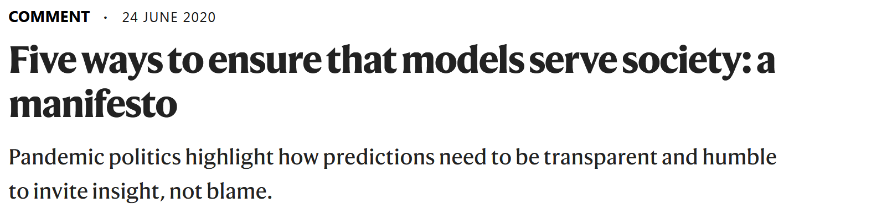

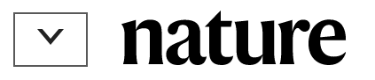

Slide 12
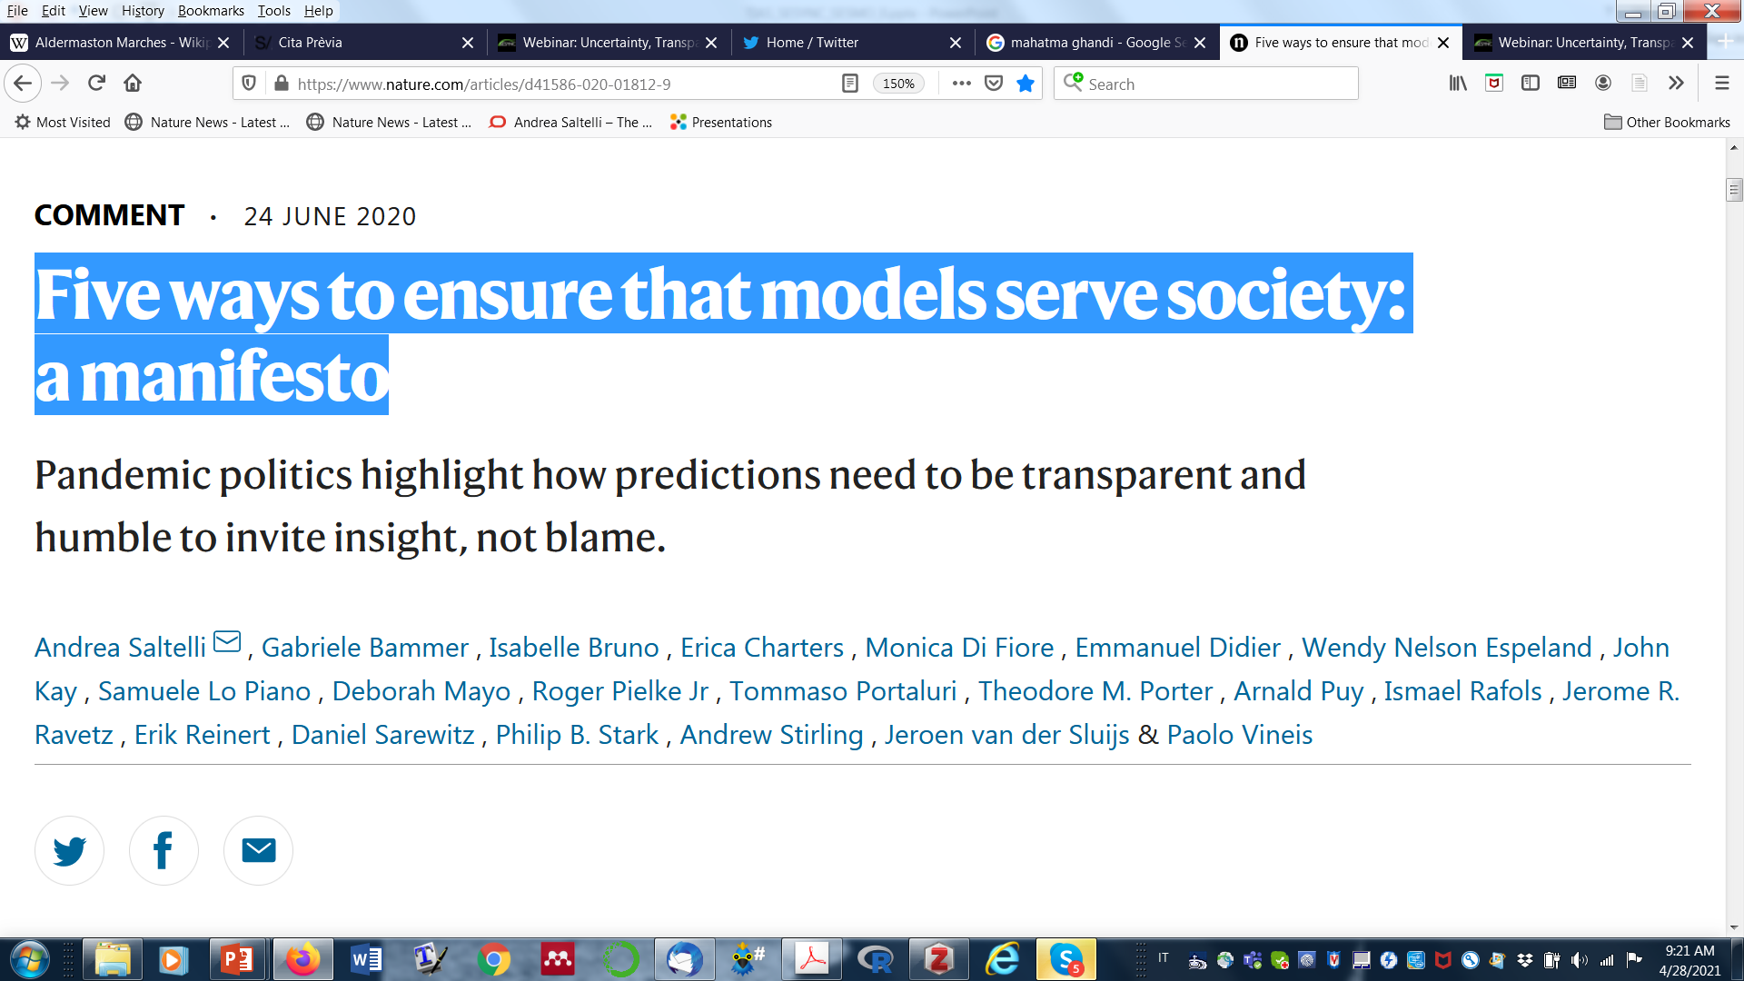
3 modellers Lo Piano, Puy, Saltelli
2 experts models and society Pielke, van der Sluijs
3 statisticians Mayo, Stark, Portaluri
2 statactivistes Bruno, Didier
2 economists Kay, Raynert
1 epidemiologist Vineis
2 sociologists of quantification Espeland, Porter
3 STS scholars Bammer, Sarewitz, Stirling
1 philosopher Ravetz
1 historian Charters
1 political scientists Di Fiore
1 expert RRI - Open Science Rafols

Slide 13
COVID has put mathematical models in the limelight
➔ Power & controversy

Slide 14

Power
Landler, Mark, and Stephen Castle. 2020. Behind the Virus Report That Jarred the U.S. and the U.K. to Action - The New York Times.

Slide 15
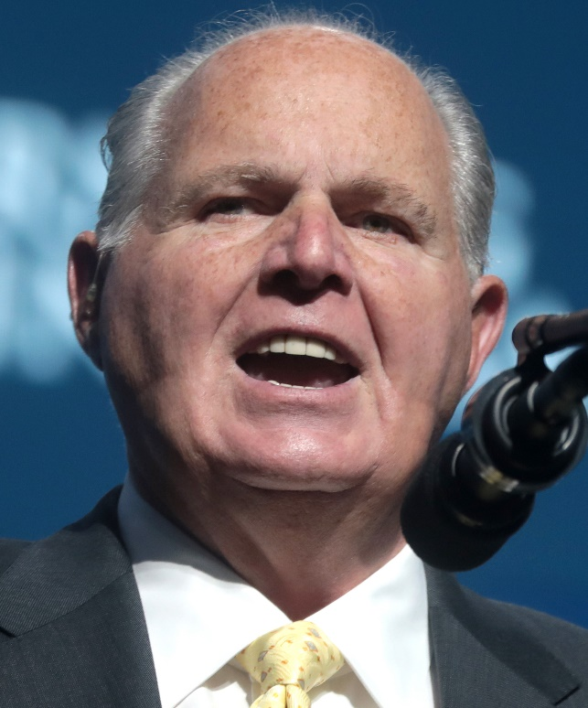
Conflicts, when questions of urgency, stakes, values and uncertainty collide
Rush Limbaugh
“Wild-Ass Covid numbers … The minute I hear anybody start talking about models and modeling, I blanch”
Rhodes, Tim, and Kari Lancaster. 2020. “Mathematical Models as Public Troubles in COVID-19 Infection Control: Following the Numbers”, Health Sociology Review 1–18. doi: 10.1080/14461242.2020.1764376

Slide 16
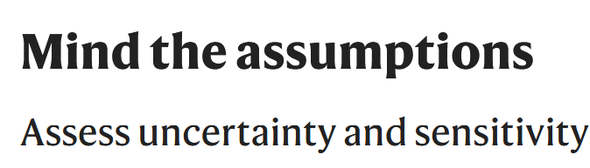
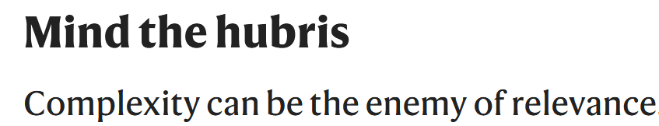
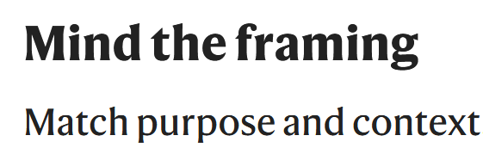
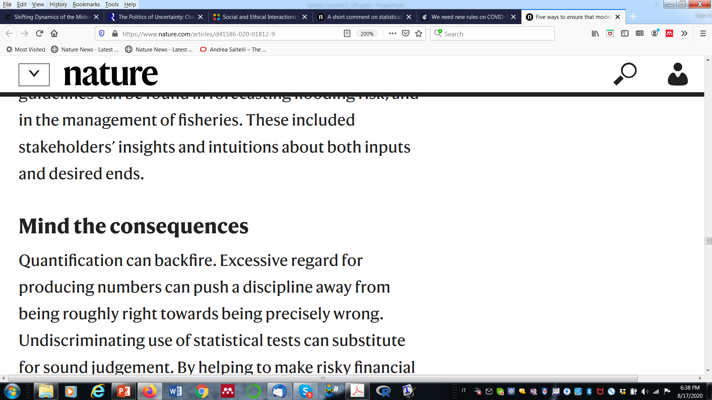
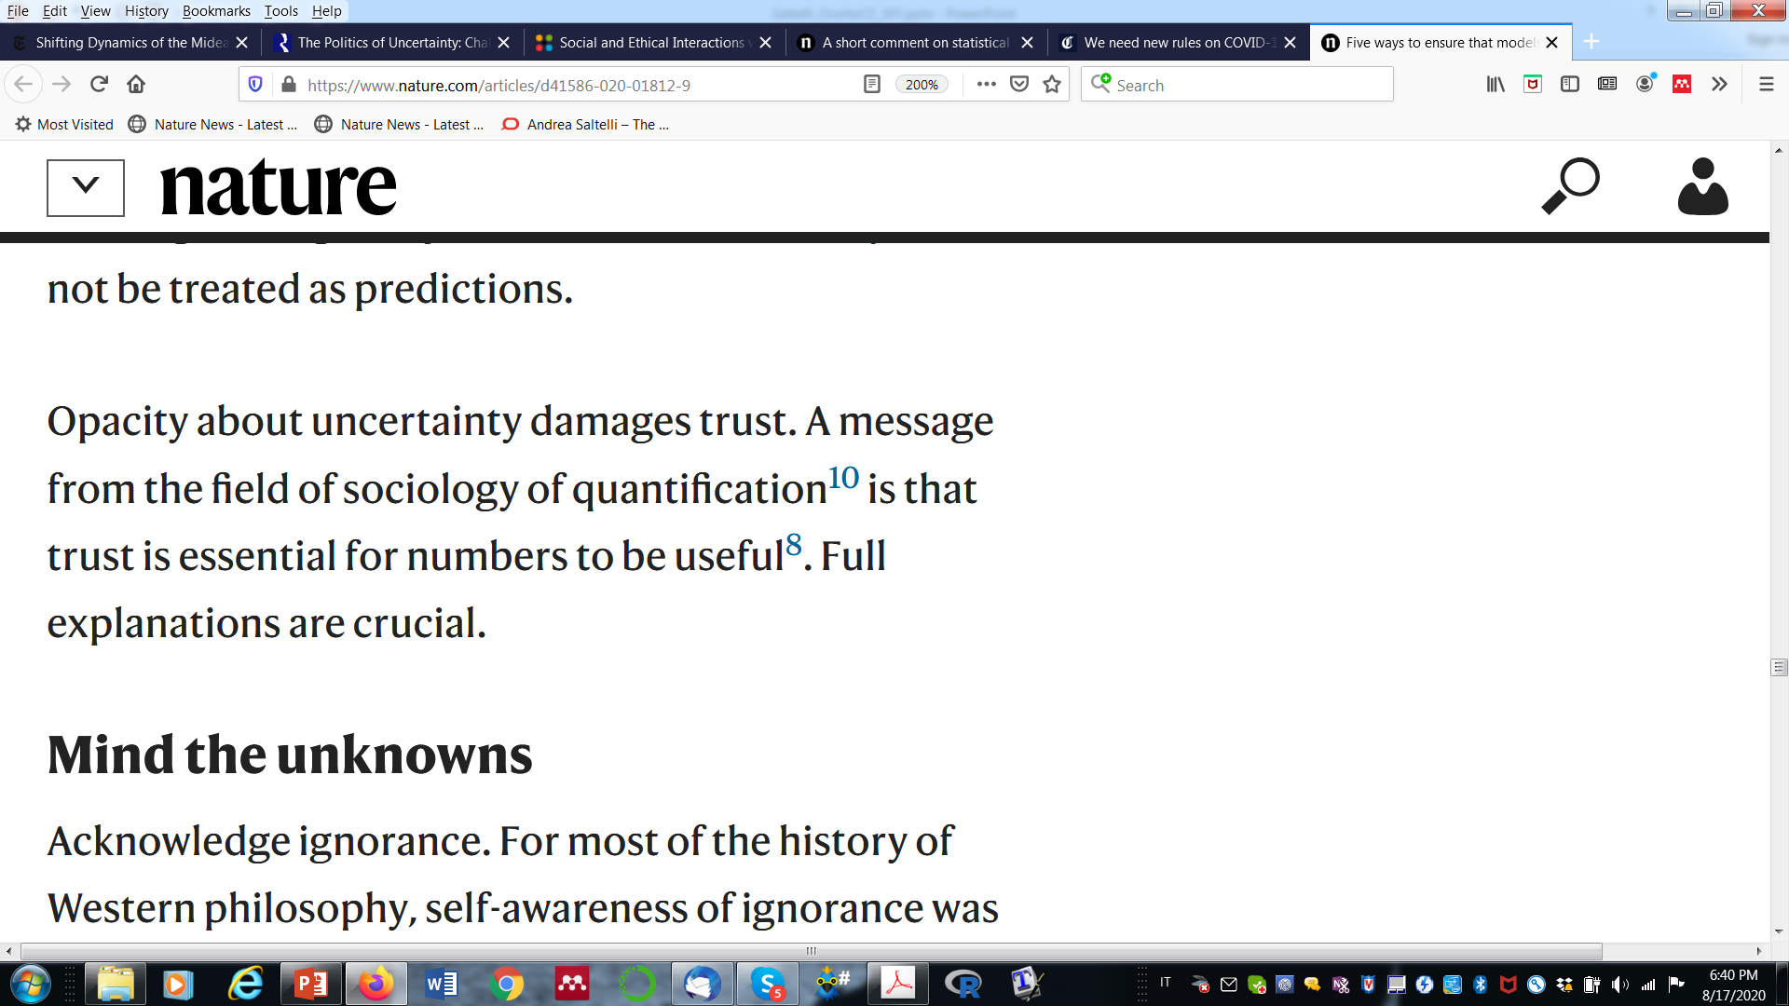

Slide 17
… models require input values for which there is no reliable information...
…global uncertainty and sensitivity analyses are often not done. Anyone turning to a model for insight should demand them …

Slide 18
… this may lead to interesting discoveries …

Slide 19

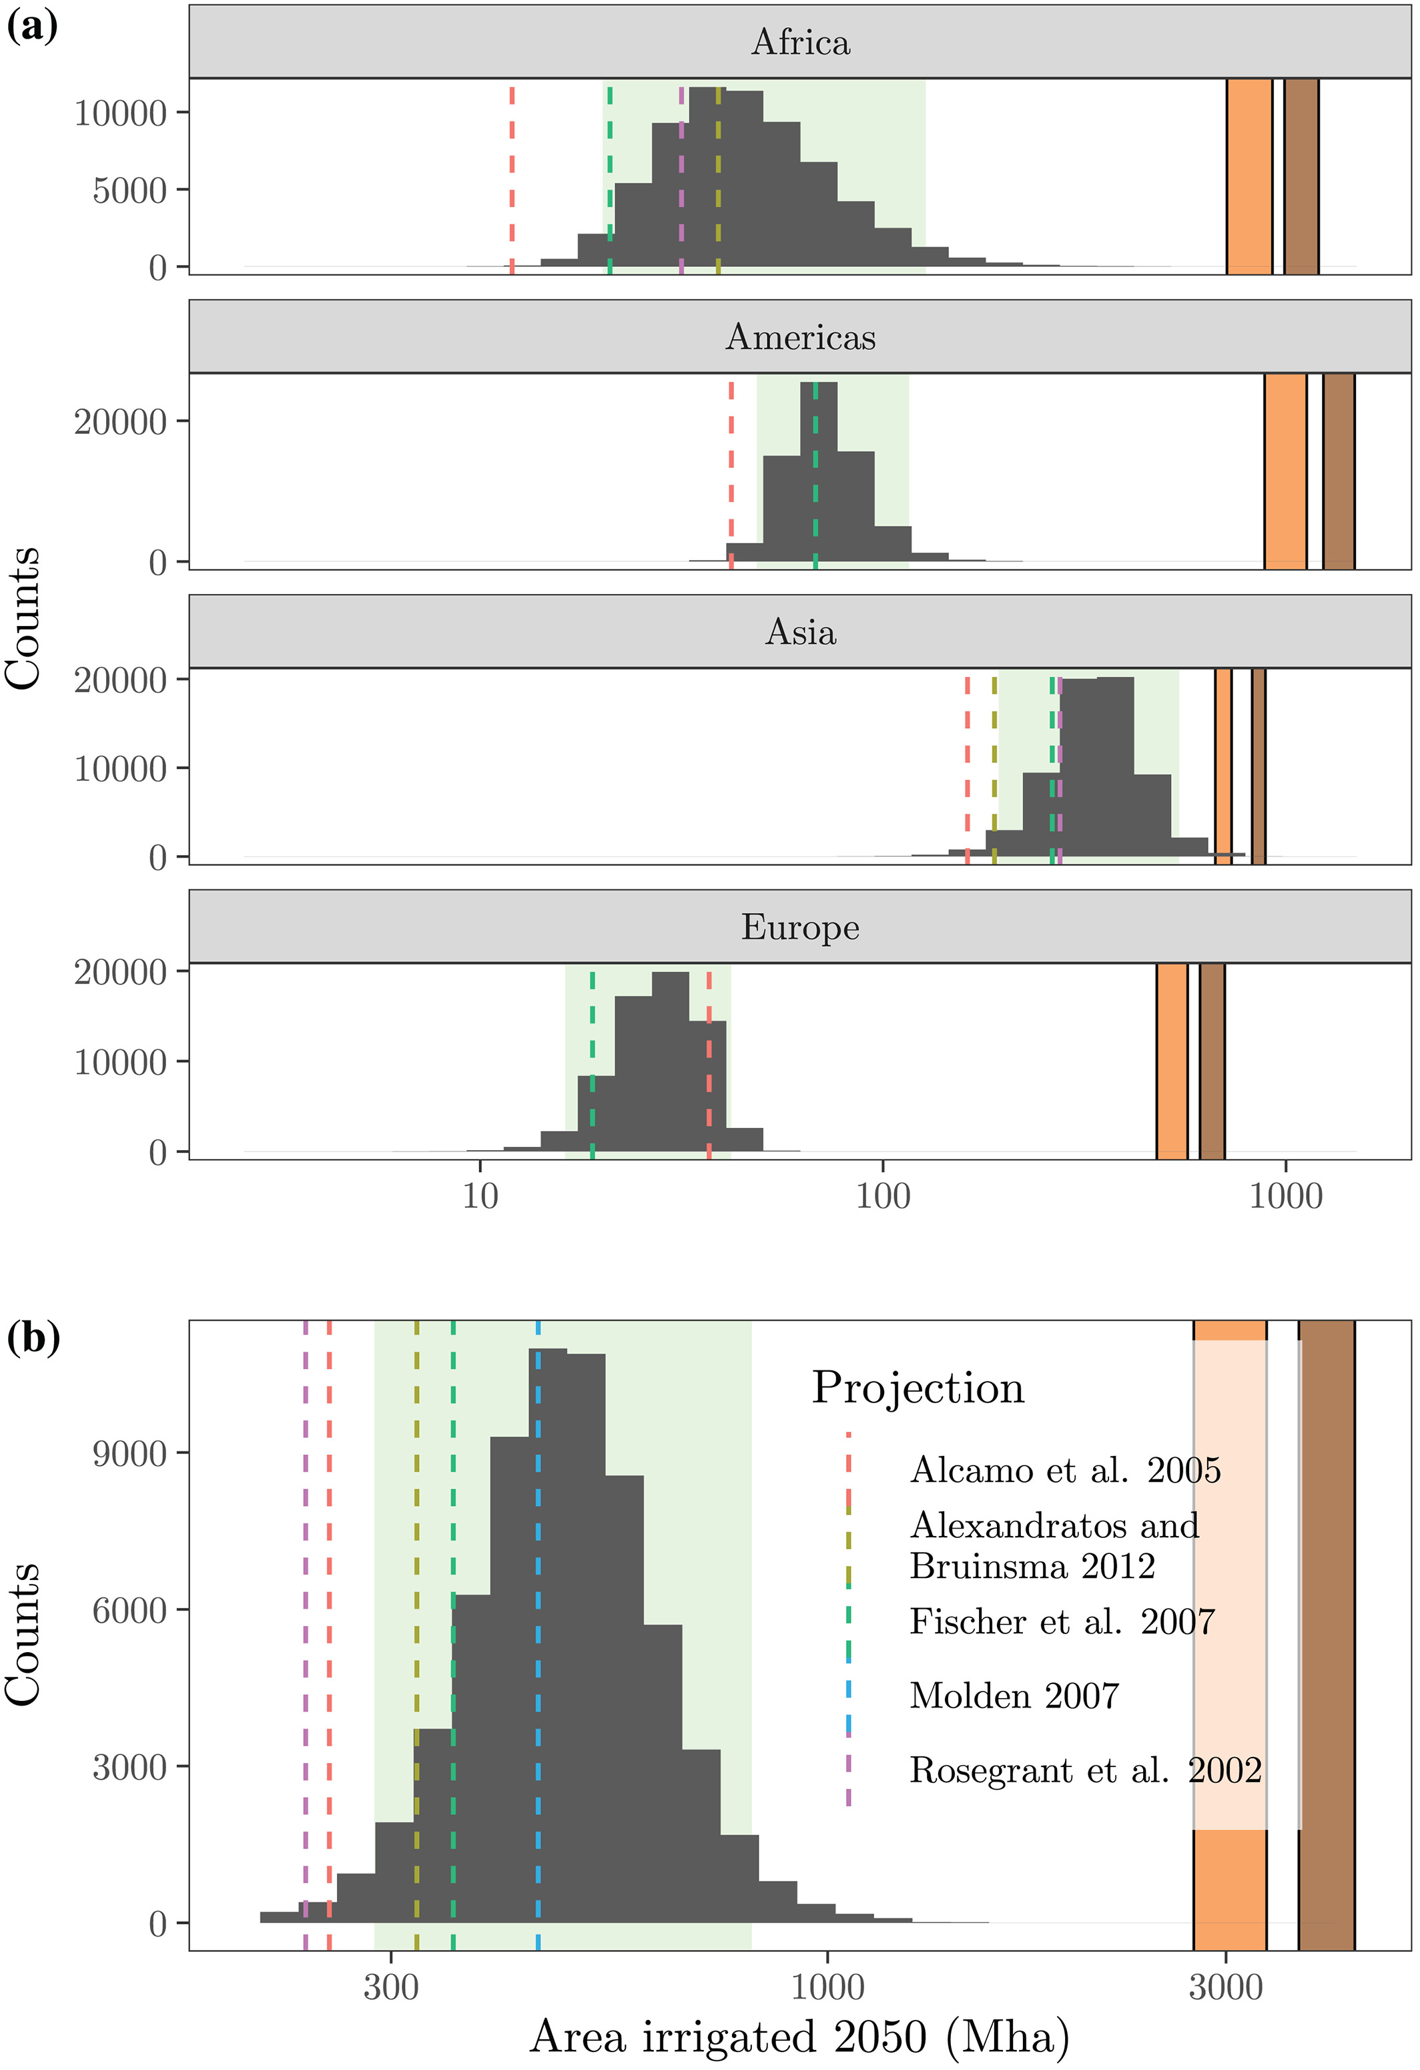

Slide 20
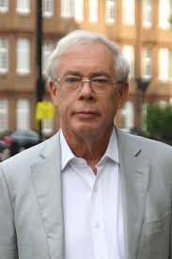
Models ask as input information which we don’t have - The case of WEBTAG
J. A. Kay, “Knowing when we don’t know,” 2012, https://www.ifs.org.uk/docs/john_kay_feb2012.pdf
John Kay

Slide 22
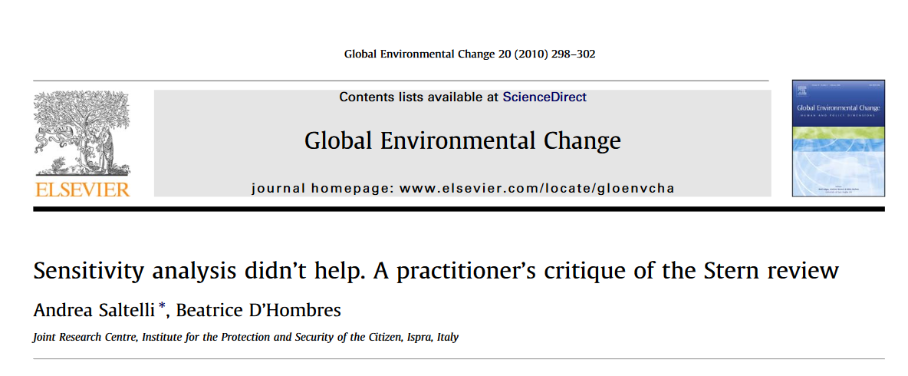
Notes:
22

Slide 23
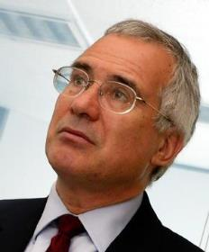
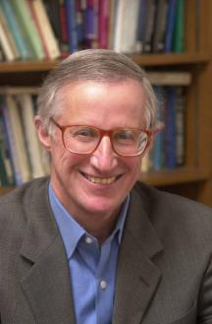
The case of Stern’s Review – Technical Annex to postscript
Nicholas Stern, London School of Economics
Stern, N., Review on the Economics of Climate Change. UK Government Economic Service, London, www.sternreview.org.uk.
Nordhaus W., Critical Assumptions in the Stern Review on Climate Change, SCIENCE, 317, 201-202, (2007).
William Nordhaus, University of Yale
Nobel ‘Economics’
2018

Slide 24
The Stern - Nordhaus exchange on SCIENCE
1) Nordhaus falsifies Stern based on ‘wrong’ range of discount rate
2) Stern’s complements its review with a postscript: a sensitivity analysis of the cost benefit analysis
3) Stern infers: My analysis shows robustness’

Slide 25
!
My problem with it:

Slide 26
… but foremost Stern says:
changing assumptions → important effect
when instead he should admit that:
changing assumptions → all changes a lot
% loss in GDP per capita
Notes:
26

Slide 27
How was it done? A reverse engineering of the analysis
Missing points
Large uncertainty
% loss in GDP per capita
Notes:
27

Slide 28
eta
scenario
delta
gamma
market
Sensitivity analysis, supports Stern: not all is driven by discount factors parameters delta and eta
Notes:
28

Slide 29
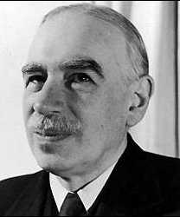
The criticism applies to both Stern and Nordhaus – both frame the debate around numbers which are …
… precisely wrong
From: Saltelli, A., D'Hombres, 2010, Sensitivity analysis didn't help. A practitioner's critique of the Stern review, GLOBAL ENVIRONMENTAL CHANGE, 20, 298-302.

Slide 30
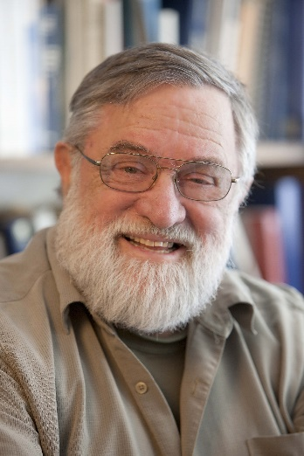
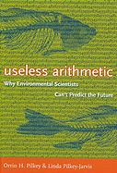
Orrin H. Pilkey
More examples in Useless Arithmetic: Why Environmental Scientists Can't Predict the Future, by Orrin H. Pilkey and Linda Pilkey-Jarvis

Slide 31

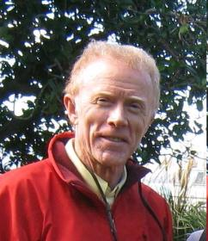
Peter Kennedy, A Guide to Econometrics.
One of the ten commandments of applied econometrics according to Peter Kennedy:
Peter Kennedy
“Thou shall confess in the presence of sensitivity.
Corollary: Thou shall anticipate criticism “

Slide 32
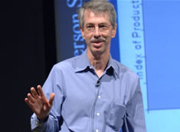
“One reason these methods [global sensitivity analysis] are rarely used is their honesty seems destructive;”
“or, to put it another way, a fanatical commitment to fanciful formal models is often needed to create the appearance of progress”
Tantalus on the Road to Asymptopia, Edward E. Leamer, 2010 Journal of Economic Perspectives, 24, (2), 31–46.

Slide 33

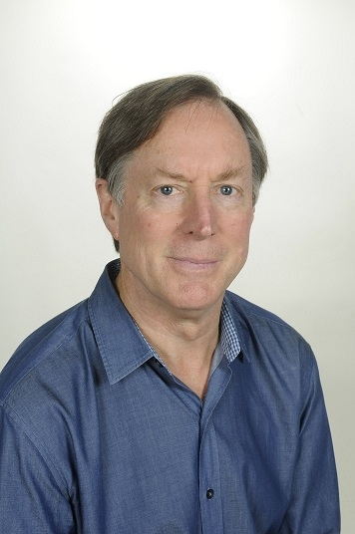
Cost benefit analysis: chapter 7 in Porter’s book Trust in Numbers”, Princeton, 1995
Theodor Porter
Notes:
33

Slide 35
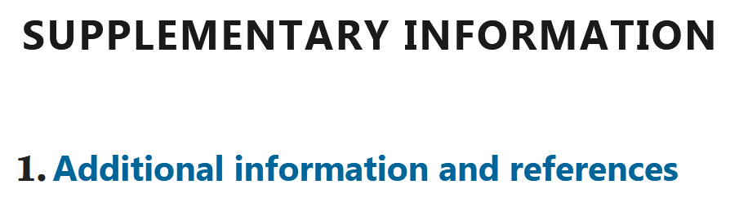
… many are seduced by the idea of adding complexity in an attempt to capture reality more accurately, but…
>260 references

Slide 36
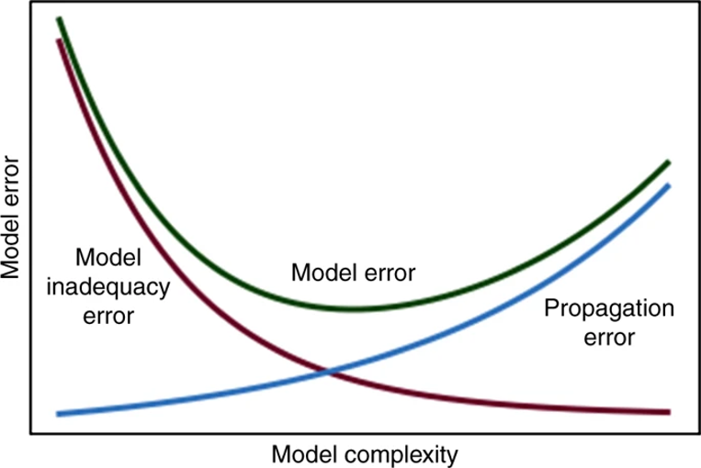

Slide 37
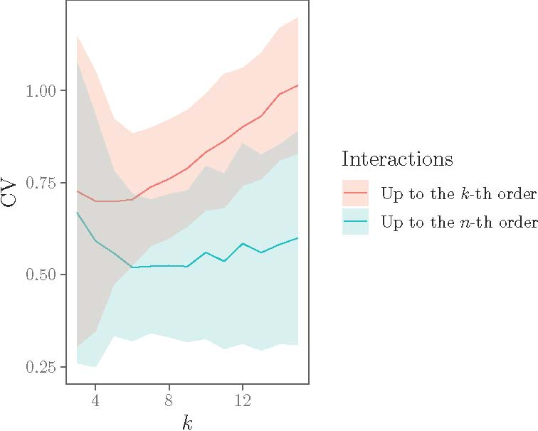
O’Neil conjecture
CV=coeff. of variation= STD/mean
k model dimensionality
with n ≤ k
From A. Puy et al, “Effective dimension and model uncertainty”, paper in progress

Slide 38
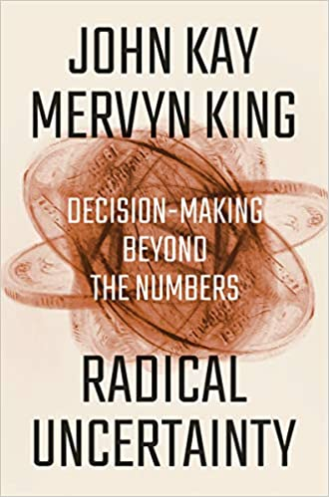
At times the simpler model gets it right because it makes the right assumptions
Predicting world fatalities from AIDS
WHO model did not consider that an HIV-positive sex worker who sleeps with 10 different people is more likely to spread the disease than someone who sleeps with the same person ten times
Kay, J. A. & King, M. A. Radical uncertainty : decision-making beyond the numbers. (W. W. Norton & Company, 2020).

Slide 40
… models will reflect the interests, disciplinary orientations and biases of the developers…
>260 references

Slide 41
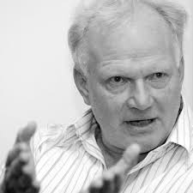
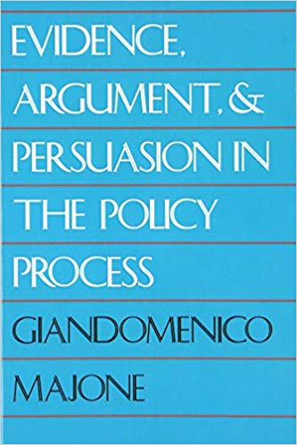

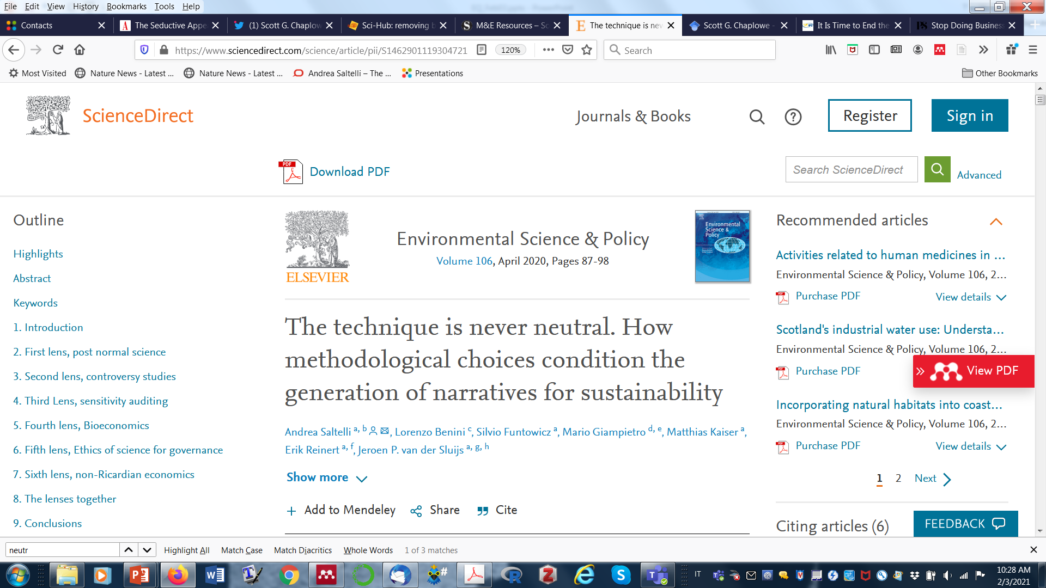
From Ulrich Beck to Giandomenico Majone: the technique is never neutral
Ulrich Beck
(1944 –2015)
1989
1992 (1986)

Slide 42
“It is not uncommon for political programs to be decided in advance simply by the choice of what expert representatives are included in the circle of advisers.”
Ulrich Beck
(1944 –2015)
1992 (1986)

Slide 43
Combine more lenses, including Post-normal science (PNS), Bioeconomics, and Non-Ricardian economics

Slide 44

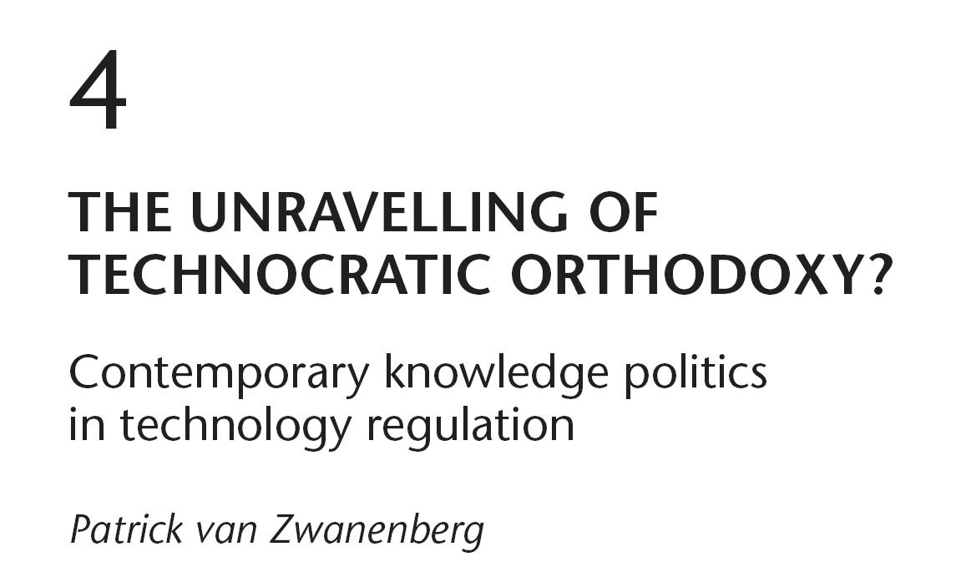
On reductionism

Slide 45
Frames as hypocognition & Socially constructed ignorance

Slide 46
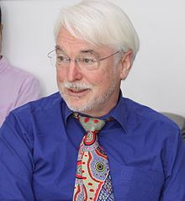
Steve Rayner
Rayner, S., 2012, Uncomfortable knowledge: the social construction of ignorance in science and environmental policy discourses, Economy and Society, 41:1, 107-125.

Slide 47
Rayner’s (2012) strategies to deal with “uncomfortable knowledge”.
Denial, Dismissal, Diversion, Displacement
Rayner, S., 2012, Uncomfortable knowledge: the social construction of ignorance in science and environmental policy discourses, Economy and Society, 41:1, 107-125.
Model based

Slide 48
Displacement: “The model we have developed tells us that real progress is being achieved” (The focus in now the model not the problem).
Rayner, S., 2012, Uncomfortable knowledge: the social construction of ignorance in science and environmental policy discourses, Economy and Society, 41:1, 107-125.

Slide 49
Example of displacement: Chesapeake Bay Program (CBP) modelling work
“Bay models are used to track nutrient loads to ensure the cap is not exceeded”
➔The model results – rather than the actual measurements, become the substance of use
Rayner, S., 2012, Uncomfortable knowledge: the social construction of ignorance in science and environmental policy discourses, Economy and Society, 41:1, 107-125.

Slide 50


Model GENESIS for beach erosion
Manipulated to support coastal-engineering projects
It neglected the role of extreme event
Sarewitz, D., Pielke, R. A. & Byerly, R. Prediction: Science, Decision Making, and the Future of Nature (Island Press, 2000).

Slide 51
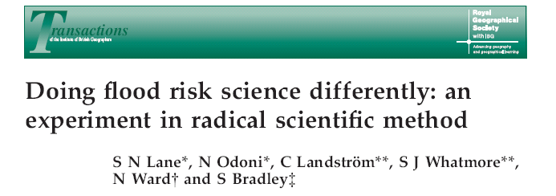
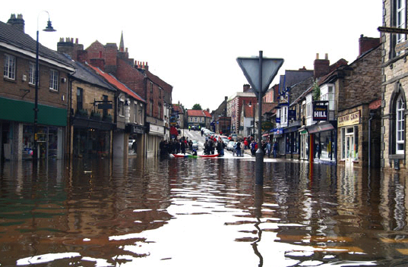

Slide 52
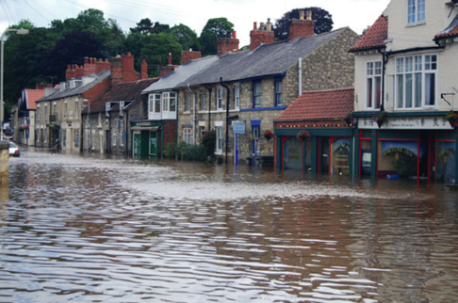
Involve stakeholders, accommodate multiple views and promote transparency, replication and analysis of sensitivity and uncertainty
Lane, S. N., Odoni, N., Landström, C., Whatmore, S. J., Ward, N. and Bradley, S., 2011. “Doing flood risk science differently: an experiment in radical scientific method.” Transactions of the Institute of British Geographers, 36: 15-36.
Notes:
52

Slide 53

[…] knowledge regarding flooding was co-produced … experts, both certified (academic natural and social scientists) and noncertified (local people affected by flooding)
➔ deep and distributed understanding of flood hydrology across all experts, certified and uncertified

Slide 54
Years of modeling stream flow and cost/benefit ratios for flood protection structures had failed to consider an
alternative intervention—upstream storage of flood waters—until local stakeholders were brought into the modeling process.
Upstream storage was neglected in the models because of the “use of a pit-filling algorithm that made sure that all water flows downhill”!

Slide 56
From the risk of financial products to the management of costal zones to the models for disaster insurance bad modelling may lead to wrong decisions
>260 references

Slide 57

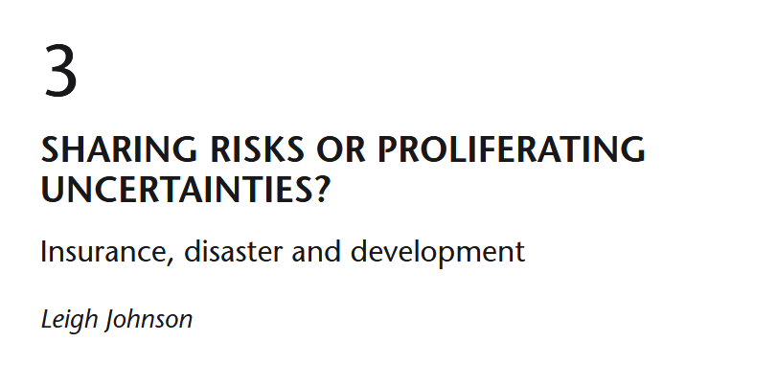
Model-based parametric insurance led to dramatic consequences for developing countries experiencing draughts
Open access: https://www.taylorfrancis.com/books/politics-uncertainty-ian-scoones-andy-stirling/e/10.4324/9781003023845

Slide 58
An ethical problem in the use of models in economics?

Slide 59
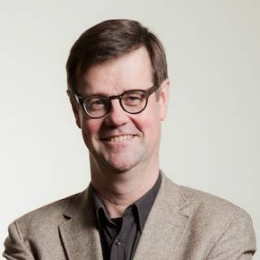
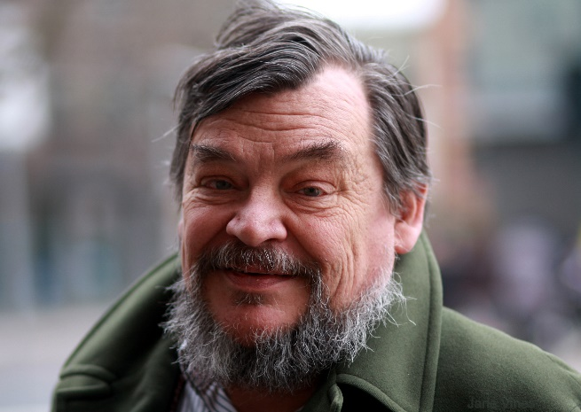
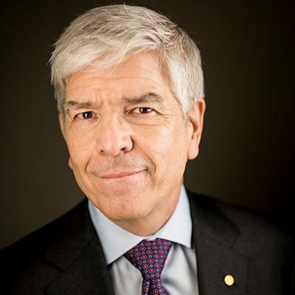
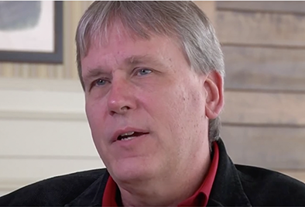
Dangers of mathematization of economics
Wolfgang Drechsler Erik S. Reinert Paul Romer Philip Mirowski
W. Drechsler, “On the possibility of quantitative-mathematical social science, chiefly economics,” J. Econ. Stud., vol. 27, no. 4/5, pp. 246–259, 2000.
E. S. Reinert, “Full circle: economics from scholasticism through innovation and back into mathematical scholasticism,” J. Econ. Stud., vol. 27, no. 4/5, pp. 364–376, Aug. 2000.
P. Romer, “Mathiness in the Theory of Economic Growth,” Am. Econ. Rev., vol. 105, no. 5, pp. 89–93, May 2015.
Mirowski, Philip. 2013. Never Let a Serious Crisis Go to Waste: How Neoliberalism Survived the Financial Meltdown. Verso.

Slide 60
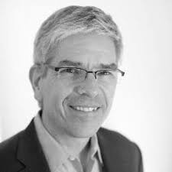
Paul Romer’s Mathiness = use of mathematics to veil normative stances
“The style that I am calling mathiness lets academic politics masquerade as science”
P. M. Romer, “Mathiness in the Theory of Economic Growth,” Am. Econ. Rev., vol. 105, no. 5, pp. 89–93, May 2015.

Slide 61
“striking parallels between the characteristics of string-theorists in particle physics and postreal
Macroeconomists”

Slide 62

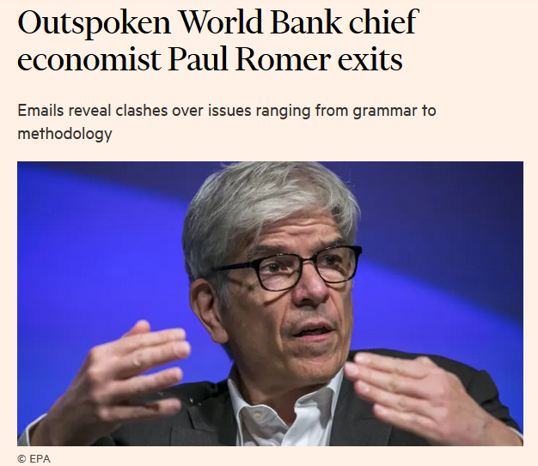
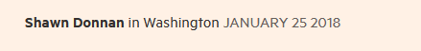
Methodological & normative conflicts, including over the methodology used in the World Bank’s “Doing Business” rankings – Romer accused the bank staff of manipulating the data for political reasons (Chile, Michelle Bachelet)
https://www.ft.com/content/be72f8e2-0144-11e8-9650-9c0ad2d7c5b5
https://www.reuters.com/article/us-worldbank-economist-romer-idUSKBN1FD38Y

Slide 63

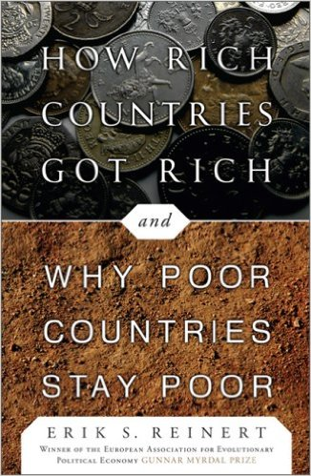
Economics has reverted to scholasticism
… forgetting an important continental tradition
… implications for developments

Slide 65
Caeteris are
never paribus
Ceteris paribus or caeteris paribus is a Latin phrase meaning "all other things being equal" or "other things held constant" or "all else unchanged“ (Wikipedia)

Slide 66

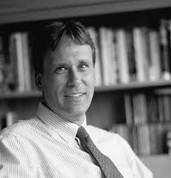
The case of DSGE, dynamic stochastic general equilibrium models
Rational expectations of agents
Efficient market hypothesis
Philip Mirowski
Philip Mirowski, 2013, Never let a serious crisis go wasted, Verso Books.

Slide 67

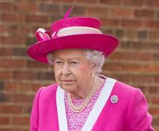
The US senate and Queen Elisabeth perplexed…
Philip Mirowski, 2013, Never let a serious crisis go wasted, Verso Books.

Slide 68
DSGE hearing in the US senate, with sworn testimony of economists such as Sidney Winter, Scott Page, Robert Solow, David Colander and V.V. Chari, to understand how ‘theorists tools’ had come to be used as policy instruments and why these instruments were all but useless in anticipating the economic crisis

Slide 69



“Beware ‘optimal’ model-land quantities obtained from imperfect simulations”

Slide 70



Modelling gamma as a constant calibrated during periods of market growth simplified the pricing of financial products (e.g. CDO) but led to disasters when the market went the other way
https://www.wired.com/2009/02/wp-quant/

Slide 71


Speculative scenario in which ten uncertain input probabilities are increased by an arbitrary 10% — as if they were truly equally uncertain — with no theoretical or empirical basis for such a choice

Slide 73

“there is no number-answer to your question”
Anthony Fauci
>260 references

Slide 74
“keep in mind at every step that the best use of metrics may be not to use it at all”

Slide 75


Jerry Ravetz
Ravetz, J, R, 2015, Descartes and the rediscovery of ignorance, in Guimarães Pereira, Â, and Funtowicz, S, Eds, 2015, The end of the Cartesian dream, Routledge.
Ravetz, J., R., 1987, Usable Knowledge, Usable Ignorance, Incomplete Science with Policy Implications, Knowledge: Creation, Diffusion, Utilization, 9(1), 87-116.

Slide 76


Slide 77

Responsible use of quantitative information; try via negativa (N. Taleb); instead of proving policy options try to falsify them

Slide 78
“…we know what is wrong with more clarity than what is right, and that knowledge grows by subtraction
… easier to know that something is wrong than to find the fix …
Actions that remove are more robust than those that add because addition may have unseen, complicated feedback loops”

Slide 79
Falsification of the available options based on:
Feasibility (compatibility with external constraints),
Viability (compatibility with internal constraints), and
Desirability (compatibility with normative values adopted in the given society)

Slide 80

Responsible modelling; reciprocal domestication between models and society

Slide 81
“Modellers must not be permitted to project more certainty than their models deserve;
and politicians must not be allowed to offload accountability to models of their choosing”

Slide 82

The End
@andreasaltelli

